Slide 1

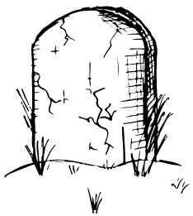
Living Threat Models Are Better Than Dead Threat Models
AppSec
PNW 2022
John S. Andersen, John L. Whiteman
Saturday, June 11, 2022
Notes:
https://www.appsecpnw.org/

Slide 2
The Opinions Expressed In This Presentation Are Our Own And Not Necessarily Those Of Our Employer

Slide 3
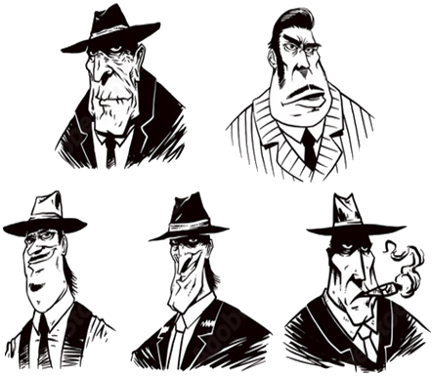
About This Presentation
STRIDE
P.A.S.T.A.
Assume that you know something about threat models (TM)
It's not about a particular TM methodology
Agnostic to TM tools
Primary focus is the collection and definition of data for TM use
VAST
Trike
DREAD
Notes:
https://as1.ftcdn.net/jpg/00/96/05/42/500_F_96054205_ucJJxEyNwrbvdeB5CqI7DOMCmObDJGU4.jpg

Slide 4

About John S. Andersen
Infrastructure and DevOps Architect - Intel Corporation
Passion for exploration and understanding
Analyzes software development methodologies and technologies to identify and proliferate best practice
Excited to explore the application of these techniques on human and AI agents.
Mission is to help foster an environment which maintains agent freedom, privacy, and security
https://www.linkedin.com/in/john-andersen-7a72b555/
Notes:
https://www.linkedin.com/in/john-andersen-7a72b555/

Slide 5

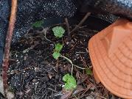
About John L. Whiteman
Security Researcher - Intel Corporation
PT Adjunct Instructor - University of Portland, UC Berkeley's Extension Cybersecurity Bootcamp
MSCS Georgia Tech, BSCS Portland State University, BA Asian Studies University of Maryland Global Campus, CISSP, CSSP, U.S. Navy Veteran, FCC (KG7VKB)
Micro Wasabi Grower and Kombucha Maker
https://www.linkedin.com/in/johnlwhiteman/

Slide 6

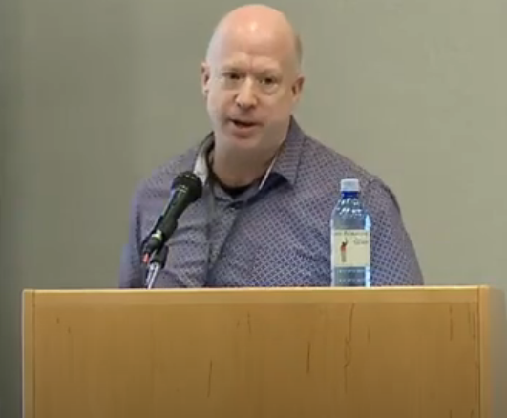
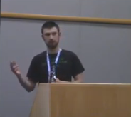
About John²
[JSA/JLW]: Both worked as security researchers for Intel Open Source Technology Center (OTC) (~2016)
[JLW/OHSU]: SAST and the Bad Human Project (2018)
Used machine learning to predict risk across hundreds of web applications without SAST
[JSA/Intel]: Down the Dependency Rabbit Hole (2019)
Used machine learning to assess risk across thousands of third-party, open-source projects to help teams determine if adoption is viable
Fundamentally, we were trying to solve the same problem ...
Notes:
https://www.youtube.com/watch?v=7dZYHRmYFeo
https://www.youtube.com/watch?v=D9puJiKKKS8

Slide 7

Living Threat Models (LTM)
Retire
Find ways to dynamically assess risks associated with projects
Collect lots of data from git repos and other sources
Define an open TM language
Integrate these systems into CI/CD frameworks
Promote and socialize our efforts for adoption
6. Retire
Notes:
https://c.pxhere.com/images/24/4f/4419f66be788ae925f2da6e7770b-1450685.jpg!d

Slide 8
When Apps Evolve, So Does the Risk And So Should the Threat Model

Slide 9
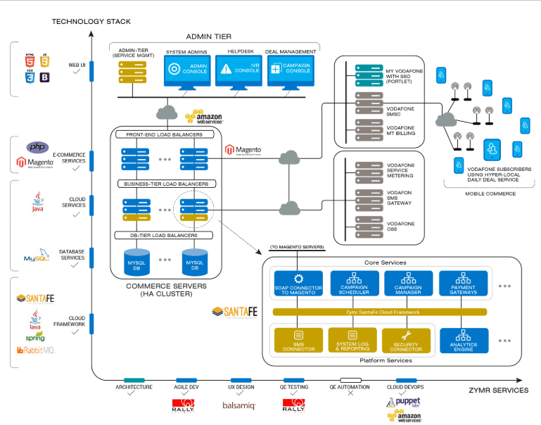
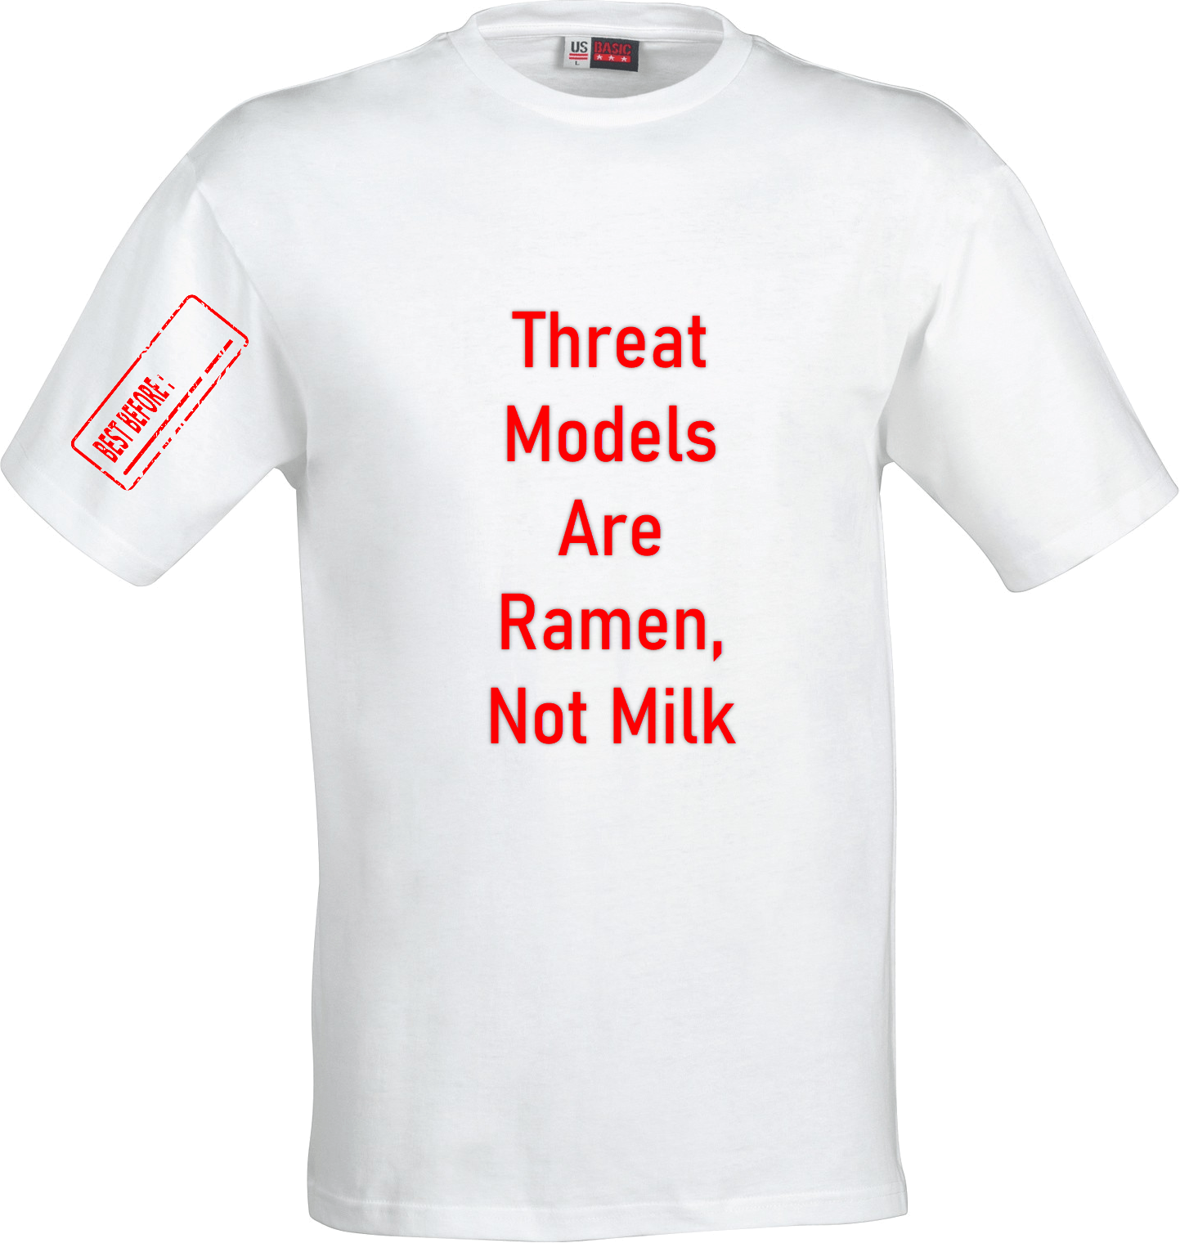

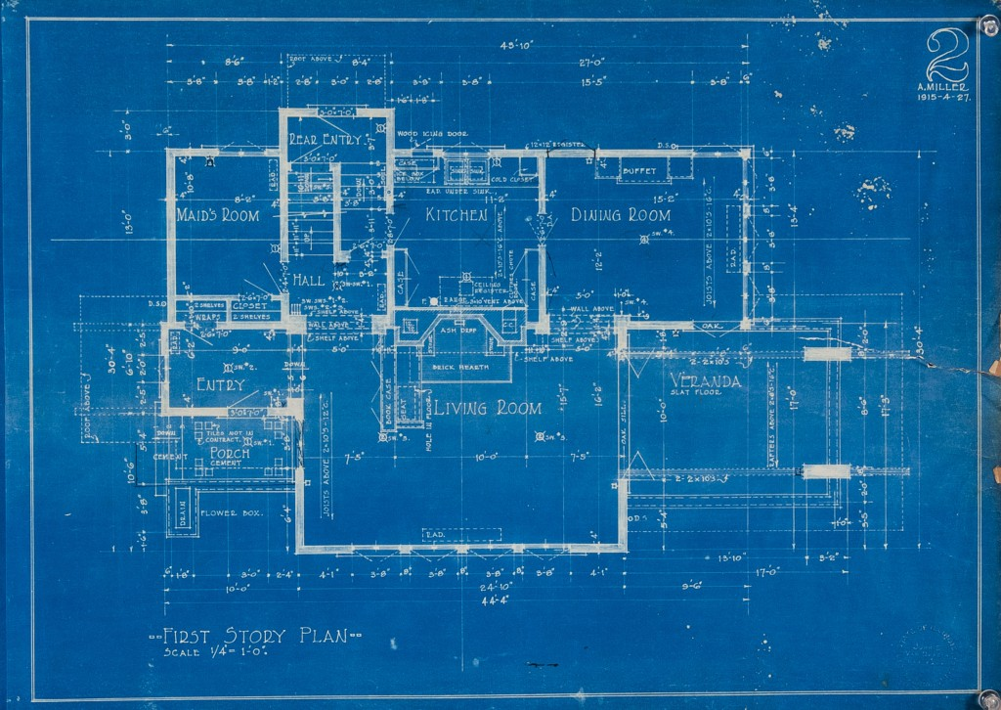
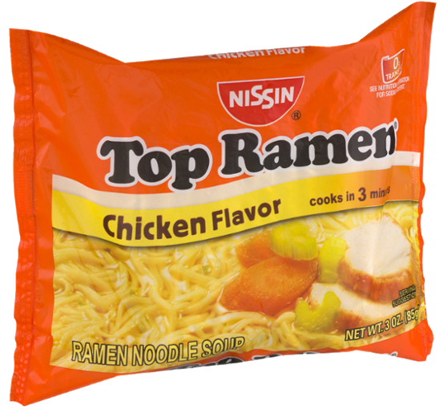

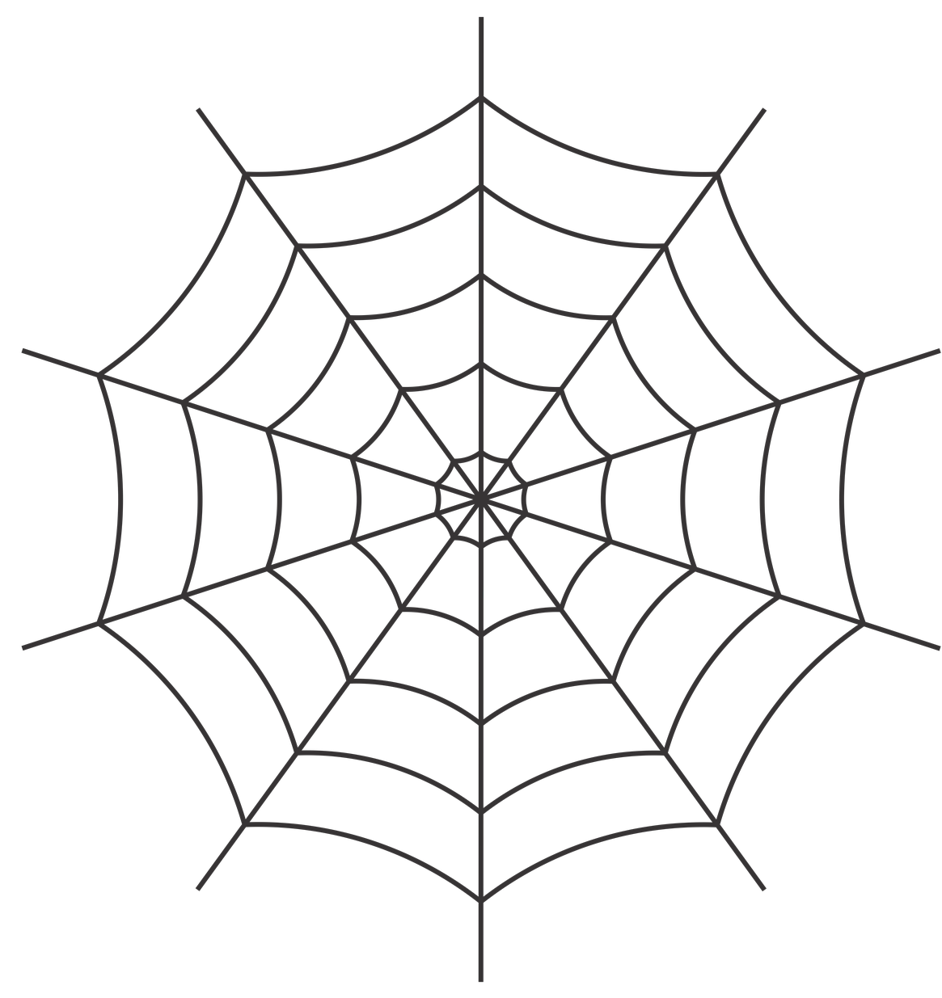


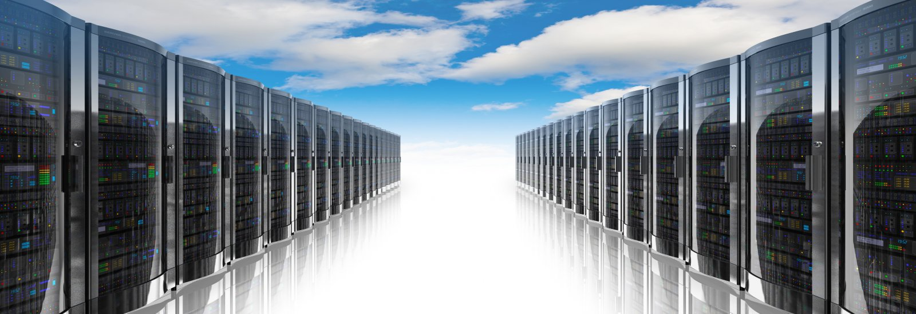
Typical TM Workflow
Architecture Design
Tombstone Threat Model Process (TTMP)
Manual code review
Static source code scanning (SAST)
Dynamic testing (fuzzing) (DAST)
Commit some code
Find and fix vulnerabilities
Init
Threat Model
TM
Release
Storage
Notes:
Best Before sounds Better than Expiration Date
https://freepngimg.com/thumb/tshirt/13-white-t-shirt-png-image.png
http://www.artit-k.com/dev-basic-oop/blueprint/
This Photo by Unknown Author is licensed under CC BY-SA-NC
https://github.com/logos
https://www.shrosystems.com/images/data_centre_cloud_1.jpg
https://epthinktank.eu/2015/02/16/best-before-date-labels-protecting-consumers-and-limiting-food-waste/
https://images-na.ssl-images-amazon.com/images/I/91iG5S-XqdL._SL1500_.jpg
https://static.turbosquid.com/Preview/2014/07/07__12_24_21/milk%20carton%200.jpgfe4a9e1c-9f28-4d6a-af7a-c32196113ec5HD.jpg
https://cdn.pixabay.com/photo/2016/07/29/04/21/web-1550385_1280.png
https://www.kindpng.com/picc/m/149-1492977_clip-art-ramen-noodles-png-ramen-maruchan-transparent.png

Slide 10
All Threat Models Should Be Machine Readable

Slide 11

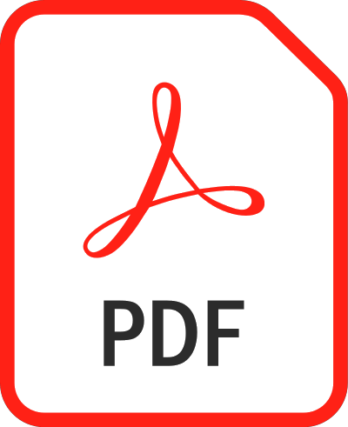




Typical TM Storage
TM
Application Specific Languages (ASL)
PowerPoint
Word
Visio
PDF
GIMP
draw.io
Notes:
https://commons.wikimedia.org/wiki/File:Microsoft_Office_PowerPoint_(2019%E2%80%93present).svg
https://commons.wikimedia.org/wiki/File:Microsoft_Office_Visio_(2019).svg
https://commons.wikimedia.org/wiki/File:Microsoft_Office_Word_(2019%E2%80%93present).svg
https://en.wikipedia.org/wiki/File:PDF_file_icon.svg
https://commons.wikimedia.org/wiki/File:JPEG_format_logo.svg
https://commons.wikimedia.org/wiki/File:The_GIMP_icon_-_gnome.svg

Slide 12
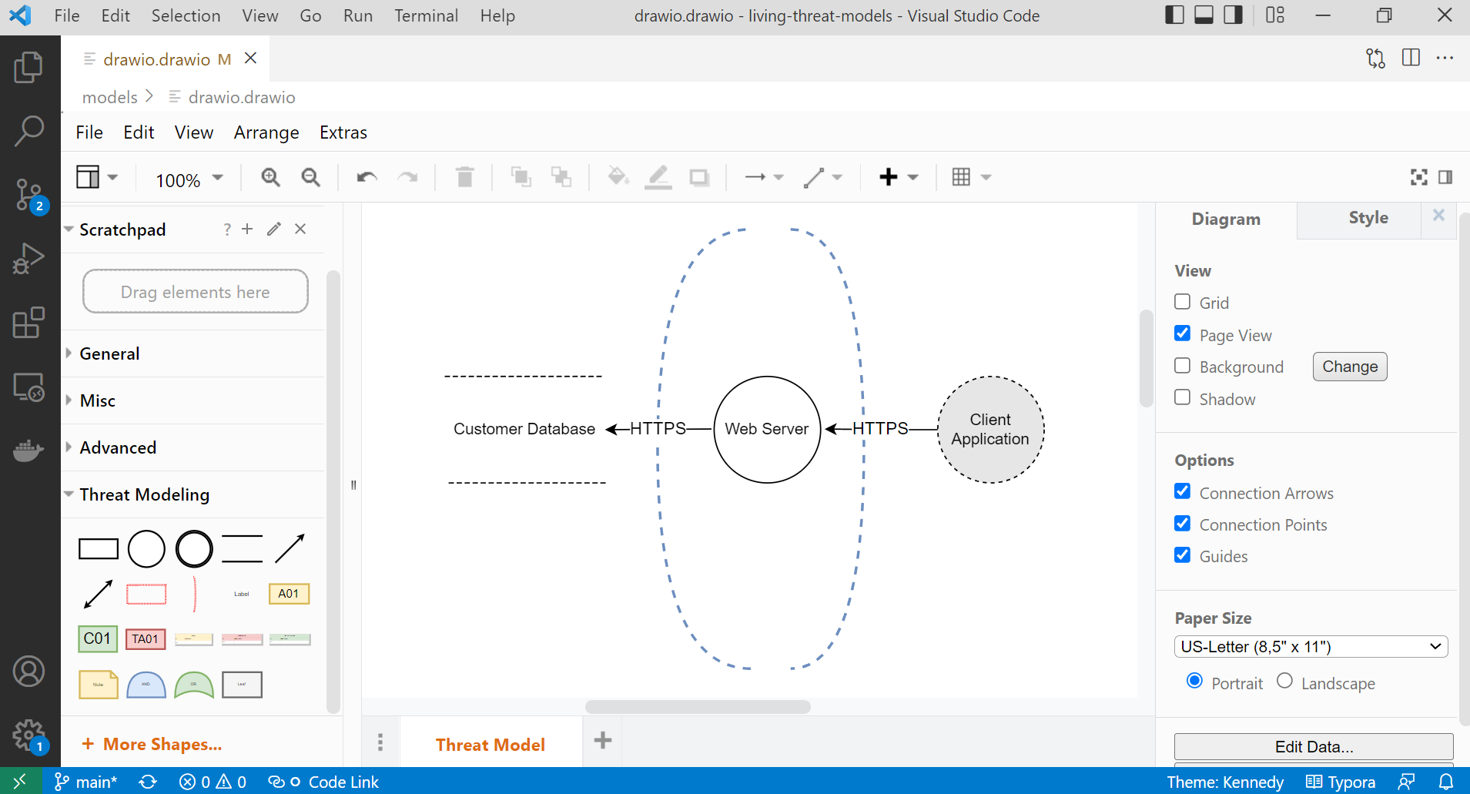
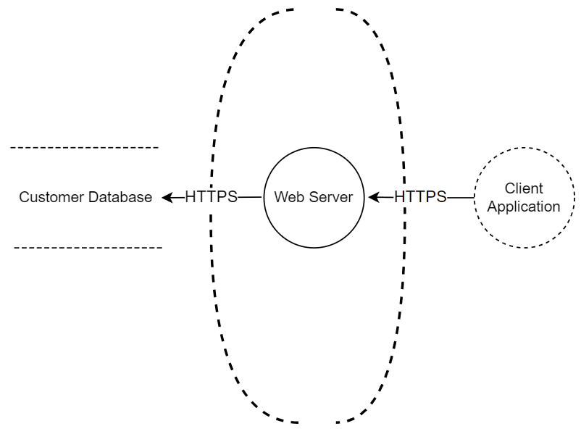
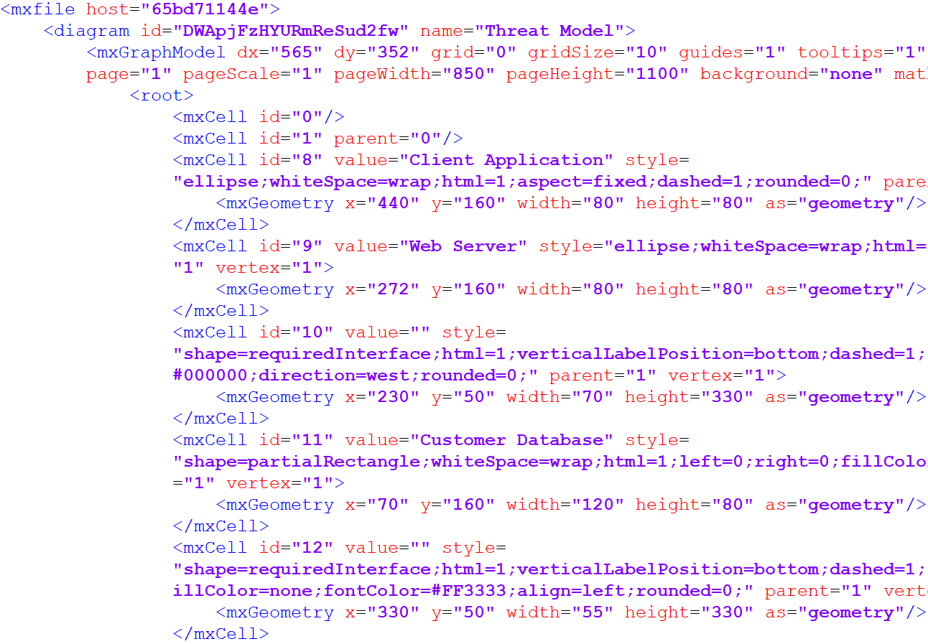
draw.io - ASL Example
Machine Readable (XML)(GPL)
Small Footprint
Complimentary, not dedicated
Mixed Content

Slide 13
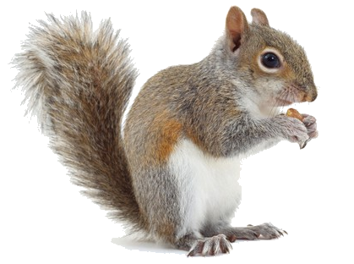
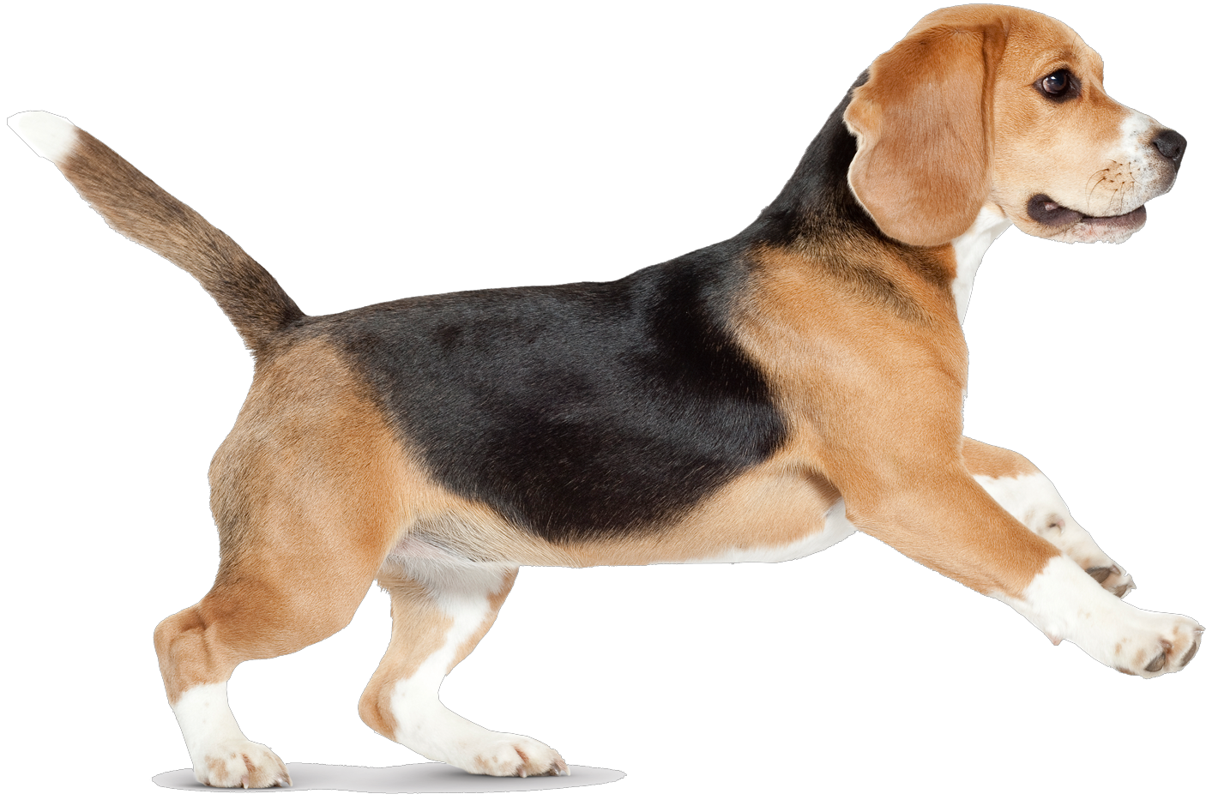
TM Tools Are Dangerously Shiny Objects
Notes:
https://images.immediate.co.uk/production/volatile/sites/22/2018/09/greysquirrelid-2ea8807.jpg?background=white&lb=620,413&quality=90
https://pngimg.com/uploads/dog/dog_PNG50331.png

Slide 14
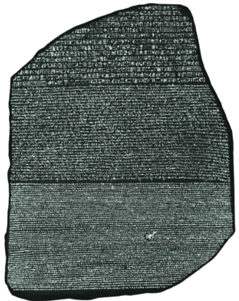
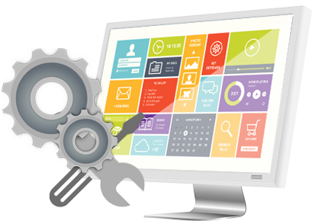

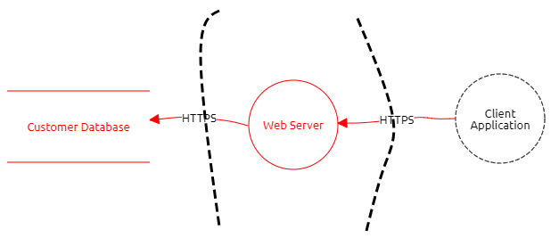
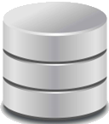
Let's Just Build a Tool That Does Everything
Diagramming, APIs, Reports, Templates, Stencils, Gamification, VR
App 1
TM Tool
ASL
App 2
Most TM-specific tools today are not CI/CD friendly
And it's not because they don't have the features to automate
It's the lack of a common, open TM language
Teams have to build custom tools to talk to other components in the CI/CD pipeline
It's hard enough to get teams to do security in the first place
Notes:
https://innovecs.com/wp-content/uploads/2020/11/building-software-development-teams.jpg
https://www.calendarpedia.com/images-large/three-year/calendar-2023-2024-2025.png
https://www.pngall.com/wp-content/uploads/2016/07/Software-Development-PNG-Image.png
https://chartattack.com/wp-content/uploads/2020/01/Team.jpg
https://cdn.careeronestop.org/OccVids/OccupationVideos/15-1199.01.jpg
https://cdn.careeronestop.org/OccVids/OccupationVideos/15-1199.01.jpg

Slide 15



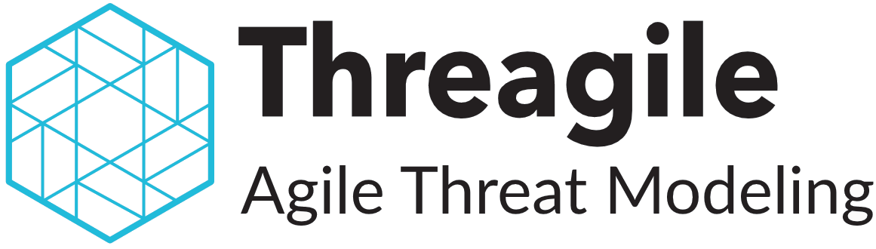

Threat Model Tools and Data Formats
Name | Type | ASL Format | Export Formats | Logo
CAIRIS | Open Source | XML | DOCX/ODT/RTF
Microsoft Threat Modeling Tool | Free (Proprietary) | XML | HTML
OWASP Threat Dragon | Open Source | JSON | PDF
Threagile | Open Source | YAML | Excel/JSON/PDF
Threat Modeler | Proprietary | XML | Excel/PDF
Two kinds of data format contexts - ASL, exported reports
Like to see GPLs used for both
Notes:
https://www.threatdragon.com/
https://owasp.org/www-project-threat-dragon/
https://docs.microsoft.com/en-us/azure/security/develop/threat-modeling-tool
https://cairis.org/
https://threatmodeler.com/
https://tm-awsmp.s3.amazonaws.com/ThreatModeler%2BInterface%2BGuide.pdf
https://threagile.io/

Slide 16
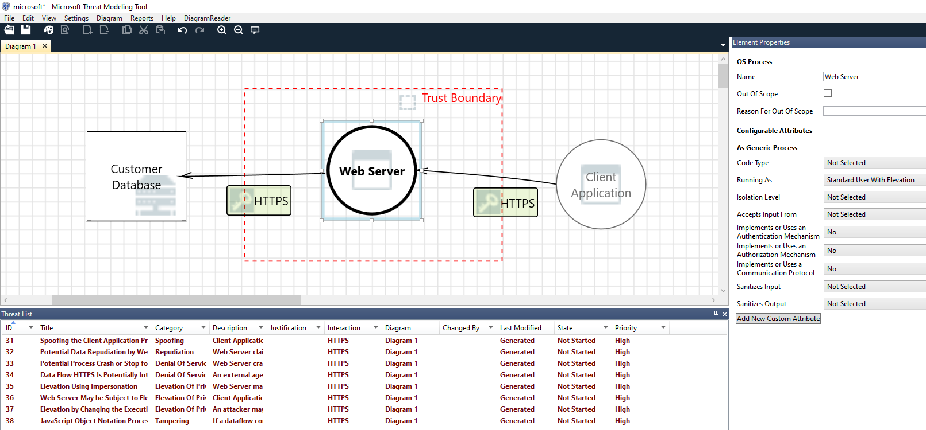
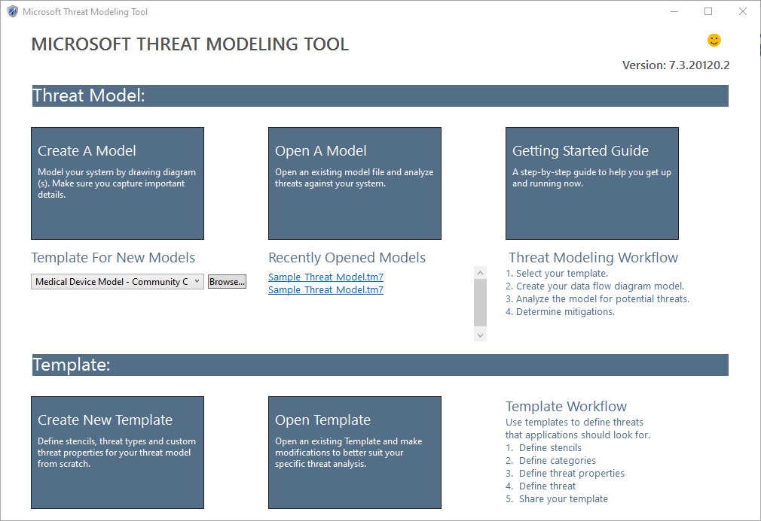
MS TM Tool - Example
Notes:
ttps://docs.microsoft.com/en-us/azure/security/develop/threat-modeling-tool
Stencils

Slide 17
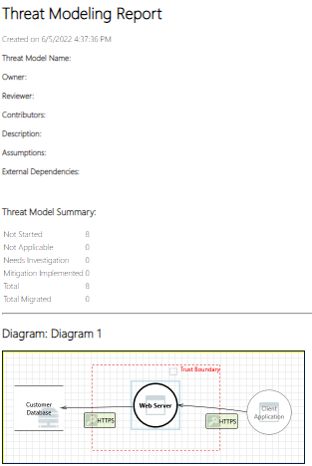
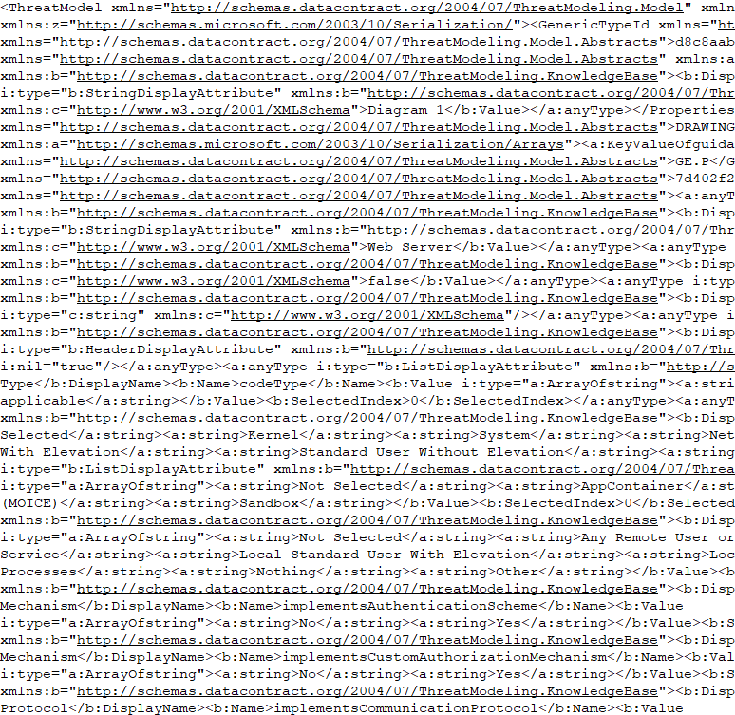
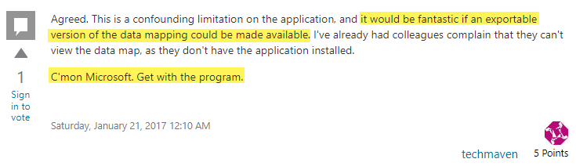
MS TM Tool - Data Formats
microsoft.html
microsoft.tm7 (ASL)
Observations
Nice tool but GUI driven
(ASL) .tm7 is ponderously parsable
Export is HTML only
Not CI/CD friendly
Open application
Export report to html
Extract embedded image (Beautiful Soup anyone?)
msdn
Notes:
https://social.msdn.microsoft.com/Forums/en-US/96cf65be-2e81-40a5-bc4a-de4f8ca4e31b/threat-modeling-tool-2016-export-tm7-to-pdf-or-visio?forum=sdlprocess

Slide 18
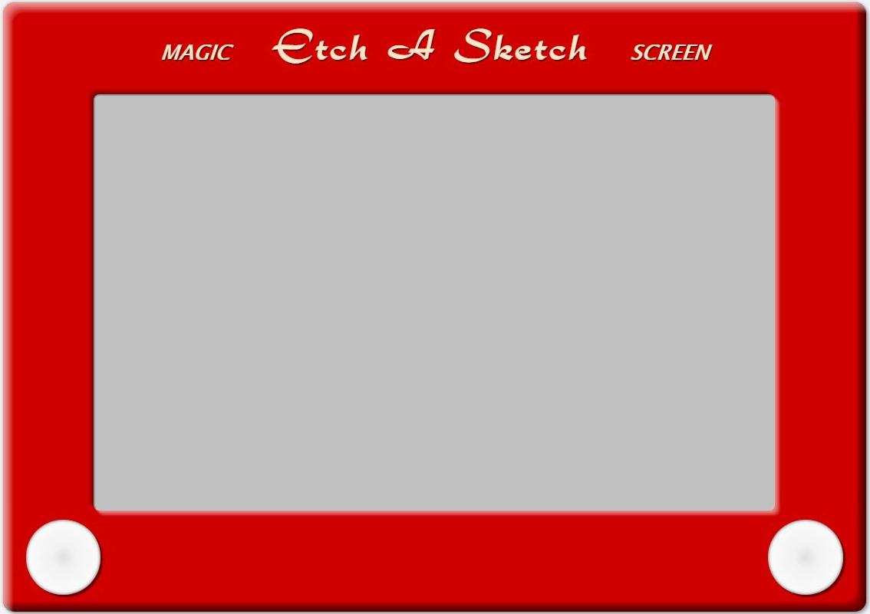
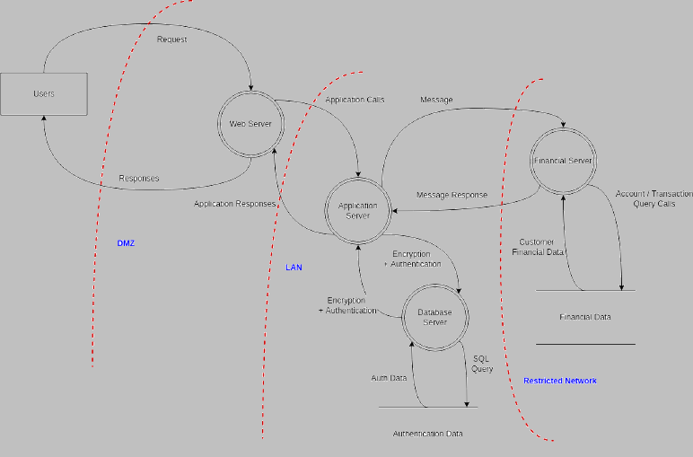
BTW - Our Favorite TM Tool
Notes:
https://724681b3-a-62cb3a1a-s-sites.googlegroups.com/site/ateachersbagoftricks/classroom-news/onlineetch-a-sketch/etch.JPG?attachauth=ANoY7cpvMftRfyiyRNDYERiOsktK5XBUxv4Y-TDgWIbIgU35rJoGMNwVL6OHnF6luyLOi3ntgLvzT5MFyWl66EsPdMUhgLzBe-hgkmwcPtuJoRYpmfJvjVgZigAFtS4X8dGfeq4GwvrYmk9UdqERX4rHbaJ440KV9fnJyefQTqBmr1p8iN-jFlrn7ndx1F8hINTJ1QCKrryKYqBoplZ9wYVpU7L3gEaWo5FifIKbqLluhSWM4NAZ42zxaBP590rNIjv7oCi5Dd6AtGLavK59P9ViwGKypY5sDg%3D%3D&attredirects=0
https://online.visual-paradigm.com/diagrams/templates/threat-model-diagram/website-threat-modeling/
https://as1.ftcdn.net/jpg/00/96/05/42/500_F_96054205_ucJJxEyNwrbvdeB5CqI7DOMCmObDJGU4.jpg
https://www.apiaviation.com/wp-content/uploads/2016/02/job-interview-be-prepared-A-1.jpg

Slide 19
More About Data Languages
Application Specific Languages (ASL)
Machine readable
Super specialized
Mixed content
Not portable, heavy
Applications
General Purpose Languages (GPL)
Machine readable
Generalized
Widely known/accepted
Portable, lightweight
JSON, XML, YAML
Domain Specific Languages (DSL)
Machine readable
Specialized
Idiomatic to domain
Compact, lightweight
HTML, SQL, Mermaid, PlantUML
Notes:
Syntax highlighting
Multiple formats

Slide 20
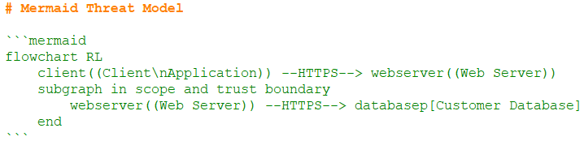
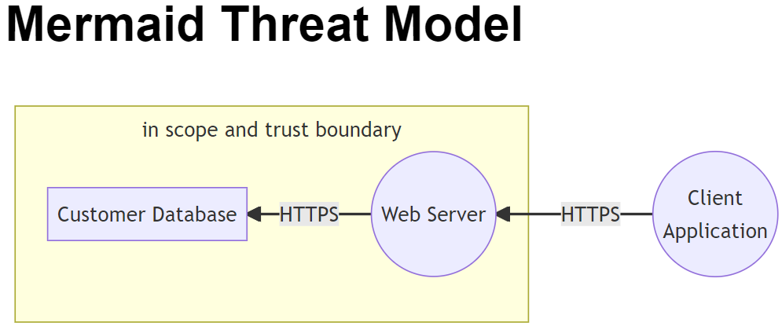
Mermaid - DSL Example
mermaid.md

Slide 21
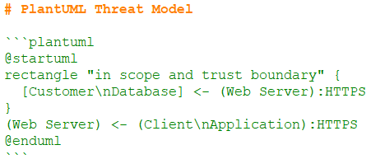
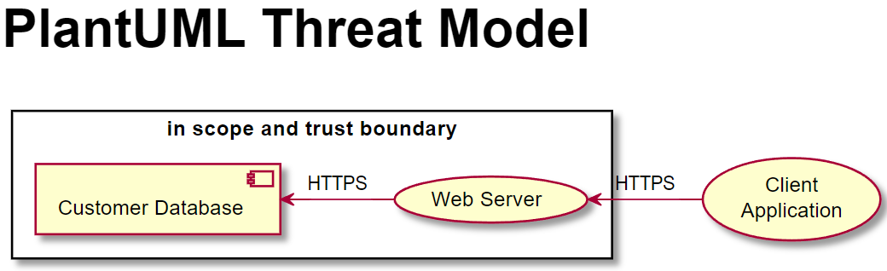
PlantUML - DSL Example
plantuml.md

Slide 22
Define an Open TM Language
Do it as an open architecture with heavy community involvement
Standards groups are a bit too snooty
DSL TM is an implementation of the language that uses a GPL to do it, e.g., JSON, XML, YAML
Avoid specialized syntax, like Mermaid and PlantUML
Define it, they will build it ... TM tools, IDE plugins, GitHub Rendering, Editors, ...
GPL
DSL TM
Open TM Language

Slide 23
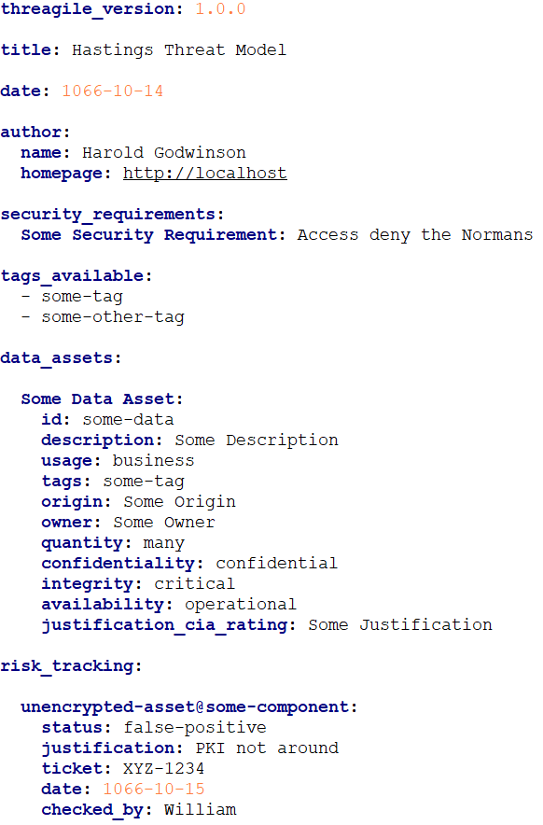
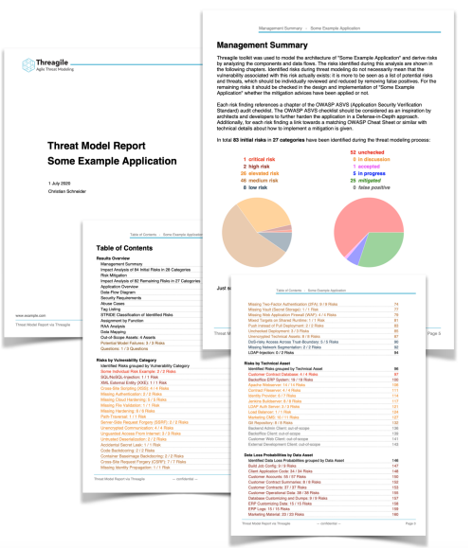
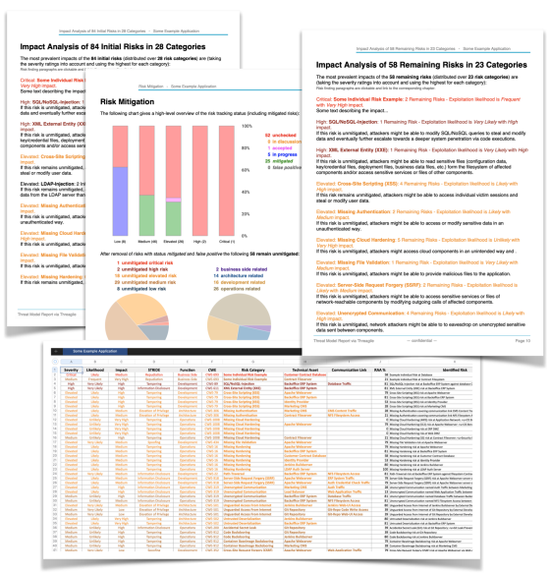
Threagile - Example
threagile.yaml
Open source tool that already does this
Not an open language though
Uses GPL YAML to define a DSL TM
Assets, flows, trust boundaries
Stores nicely in the repo as text
CI/CD cmdline tool (threagile) (golang) ingests the YAML file to generate reports, audits
Notes:
https://www.youtube.com/watch?v=5n-8LqHMoJ0
https://github.com/Threagile/threagile/blob/master/demo/example/threagile.yaml
https://threagile.io/
https://github.com/threagile
https://deepsec.net/docs/Slides/2020/How_To_Combat_Risks_Directly_From_Within_Your_IDE_Christian_Schneider.pdf

Slide 24
Scan Threat Models Like You Scan Code

Slide 25
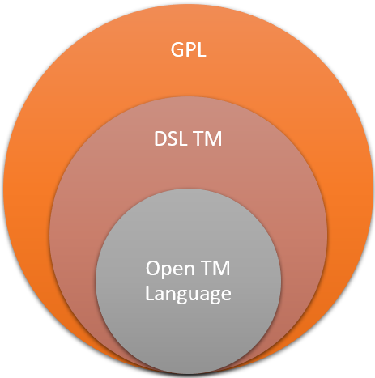
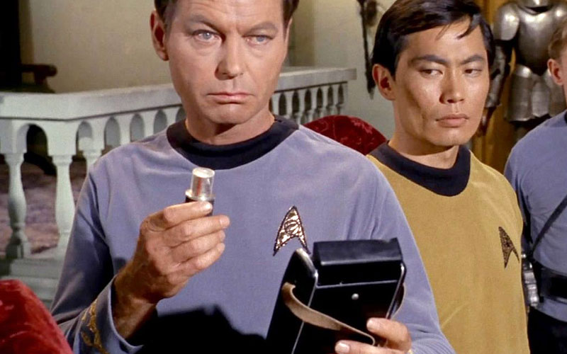
CI/CD Automated Scans for TMs
With an open TM language, we can do the following:
Quality Checks (Linter)
Missing assets, labels, ...
Duplicate names
Age (Best Use Before Date)
Vulnerability Checks (SAST)
Lack of or incorrect mitigations
Discrepancies between TM and source code
e.g., source code contains networking libraries but the TM says nothing about using networks
Notes:
https://treknews.net/wp-content/uploads/2017/03/bones-mccoy-medical-tricorder.jpg

Slide 26

OWASP Threat Dragon
Let's use our very own Threat Dragon to make a point!
Open source threat model tool
Goodwin/Gadsden/Reading et al.
Two flavors: Standalone or Web App
Latter nicely integrates into GitHub
TMs are machine readable (sort of)
ASL -> JSON, Exports -> PDF
Notes:
https://github.com/OWASP/threat-dragon
https://www.threatdragon.com/
https://owasp.org/www-project-threat-dragon/

Slide 27
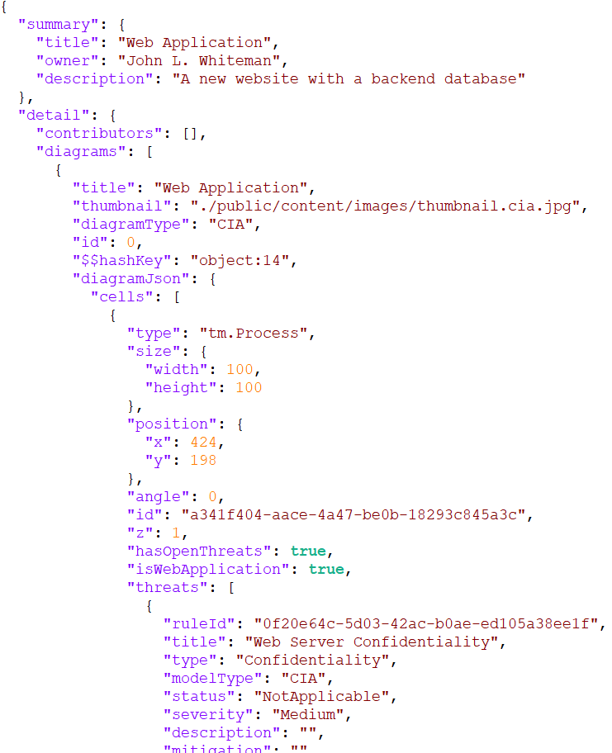
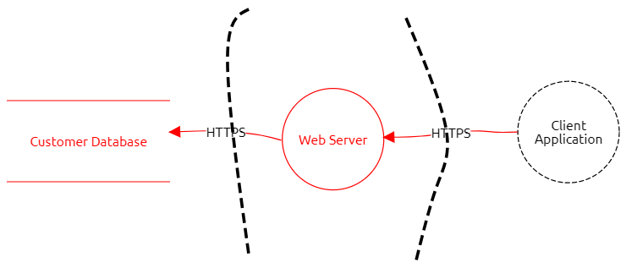
Threat Dragon TM
ASL Data
JSON (GPL)

Slide 28
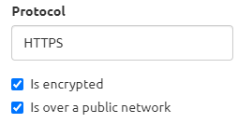
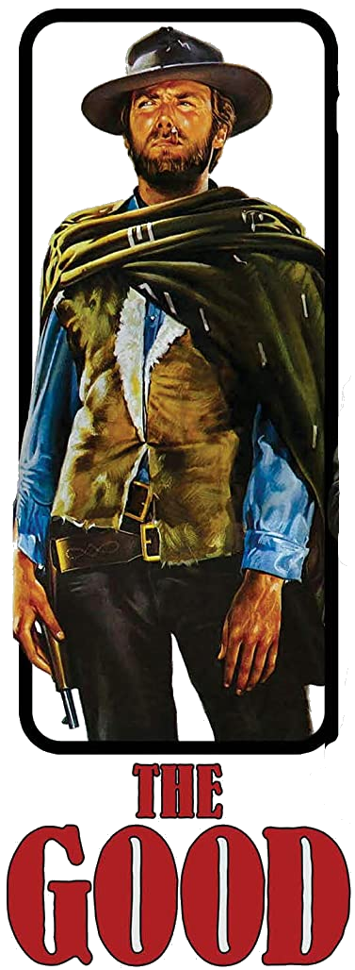
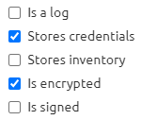
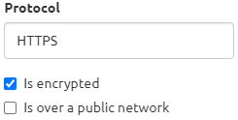
Threat Dragon TM (Good)
good.json
Notes:
https://www.amazon.com/Good-Bad-Ugly-Anniversary-Single/dp/B07MS59ZL6

Slide 29
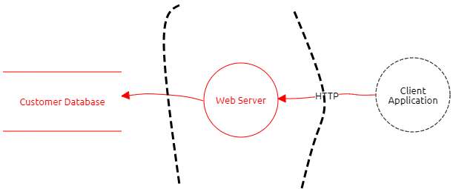
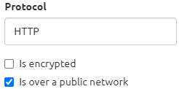

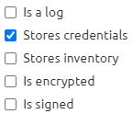
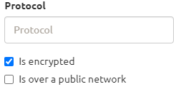
Threat Dragon TM (Bad)
Intentionally Vulnerable Threat Model
bad.json
Notes:
https://www.amazon.com/Good-Bad-Ugly-Anniversary-Single/dp/B07MS59ZL6

Slide 30


Threat Dragon TM (Ugly)
What is an ugly threat model?
No threat model ...
∅
... at all!
ugly.json
Notes:
https://www.amazon.com/Good-Bad-Ugly-Anniversary-Single/dp/B07MS59ZL6

Slide 31
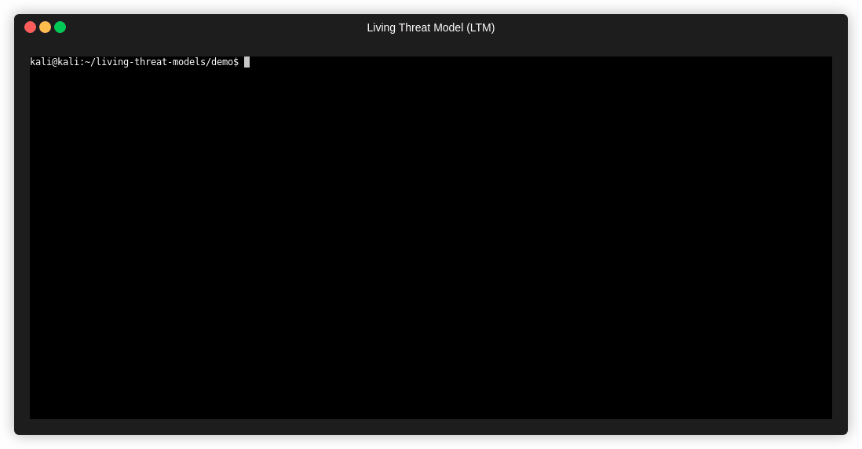
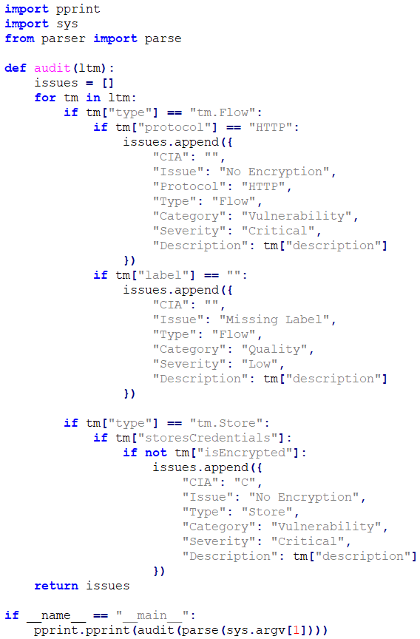

Threat Dragon TM Scanner Demo
parser.py
auditor.py

Slide 32
Put the TM in the CI/CD Workflow
Notes:
Why do we not see more threat models in git repositories

Slide 33

TM As Branch
Initial check-in is TM done manually
Code changes that don't affect LTM are merged directly to main {∅}
Code changes that affect the LTM are first merged to ltm branch {Δ}
LM changes, e.g., 0 Day Vulnerabilities, can precede code changes
Notes:
What comes first, chicken, egg or threat model

Slide 34

TM Without Branch
Initial check-in is TM done manually
TM is included as part of the regular check-ins on same branch
TM is scanned along with code
Caveat: No promise of full automation, some human interaction needed

Slide 35
THREATS.md Is the New README.md

Slide 36



README.md
Simple markdown file with a special purpose in GitHub
Resides at the root of the repo directory - can always find it
HTML along with those```<lang>```

Slide 37


Overlays - CITATIONS.cff

Slide 38


Overlays - THREATS.md
DSL TM
Overlays
DSL TM

Slide 39
Must Feed the TM to Keep It Alive

Slide 40

DFFML Demo
https://intel.github.io/dffml
https://github.com/intel/dffml
Notes:
https://github.com/intel/dffml
https://intel.github.io/dffml/

Slide 41
References
Andersen, J. S. (2019). Data Flow Facilitator for Machine Learning (DFFML). https://github.com/intel/dffml
Andersen, J.S. (2019). BsidesPDX: Down the Dependency Rabbit Hole. [Video]. YouTube. https://www.youtube.com/watch?v=D9puJiKKKS8
Andersen, J. S. & Whiteman, J. L. (2022). Living Threat Models. https://github.com/johnlwhiteman/living-threat-models
Goodwin, M. & Gadsden, J. & Reading, L. (2015). OWASP Threat Dragon https://github.com/OWASP/threat-dragon
Hysn Technologies. (2020). Awesome Threat Modeling. https://github.com/hysnsec/awesome-threat-modelling
Schneider, C. (2020). Threagile. https://github.com/hysnsec/awesome-threat-modelling
Whiteman, J. L. (2018). BSidesPDX: SAST and the Bad Human Code Project. [Video]. YouTube. https://www.youtube.com/watch?v=7dZYHRmYFeo

Slide 42
Thank You!

